Slide 1
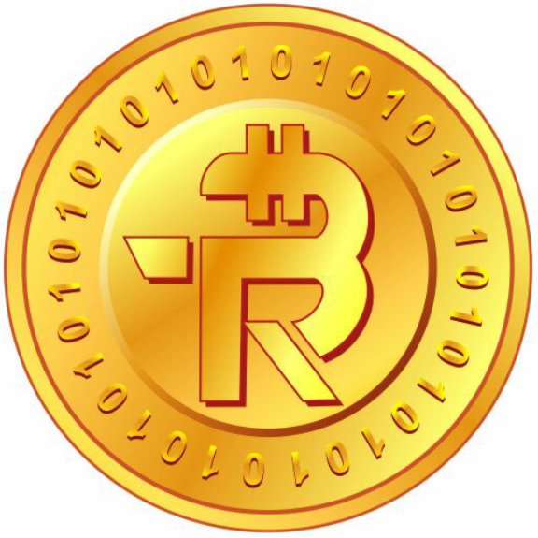
Bitether (BTR)
Innovation to Secure Your Financial Transactions….!!!

Slide 2
What is Bitether (BTR)?
Bitether (BTR) is a peer to peer decentralized digital crypto token made on Bitcoin Blockchain via Counter Party Proof of Stake (PoS) Algorithm.
BTR follows the below characteristics:
Anonymous Currency
Transperant Public Ledger
Fast Transfer with Low Fees
World Wide Transactable
Limited Supply

Slide 3
About MAK International
“Mak International is the founder company of Bitether (BTR)”
MAK International, is the Crypto Currency Education Training Company actively working in the Crypto Industry since 2013.
MAK International is associated with Real Estate Development Industry Too.
We have already conducted 100+ seminars and presentations on Crypto Currency and Blockchain Technology.
Looking at our in-depth Knowledge, Motivation and Passion towards the crypto field, many people who attended our seminars and presentations ask us to create our own crypto currency or digital token.
Thus, we have planned and created our own digital crypto token named “Bitether”.

Slide 4
Mission
Take Bitether (BTR) into the list of top traded crypto currencies in the world till 2020.
Make Bitether (BTR) most valuable crypto currency in term of market capitalization.

Slide 5
Vision
Make Bitether (BTR) an incredible Payment gateway for online and offline users till 2025
Enter into maximum countries of the world as most trusted plateform for financial transactions.

Slide 6
About ICO
ICO stands for Initial Coin Offerings by which, token or currency founder raise funds from the different investors from different countries using Crowd Funding. Using ICO, most of the crypto currencies of the world came into existence.
We have also selected the same way to get into the crypto market.
But with New Innovative idea of Crypto Mutual Fund Concept (First Ever in Crypto World)
BTR ICO’s Unique Features:
Token Distribution
ICO Phases & Bonus
Listing of BTR
Fund Utilization (Back up of BTR)
Quarterly Dividend Policy
Redemption Options

Slide 7
Token Distribution Pattern
Total no. of Pre mined BTR is 550,000,000. This is locked limited supply. We have planned to distribute Bitether in very unique pattern as follow:

Slide 8
Token Distribution Pattern

Slide 9
ICO (103,125,000 BTR) Distribution
1 Cycle Distribution:
No. of BTR | Duration
1,250 | 10 Min.
7,500 | 60 Min. (1 Hour)
180,000 | 24 Hours (1 Day)
5,400,000 | 30 Days (1 Month)
48,600,000 | 9 Months (1 Cycle)
After completing Every Cycle, the issuance of BTR will be halved..
This Issuance will be finished in 34 cycles i.e. 25 years and 6 Months.

Slide 10
ICO Phases
We have kept the distribution of BTR in three unique phases as follow:
Phase – I (Cold Constant Phase): In the first phase of ICO, the rate of BTR will be $0.01 constant for the period of 30 days from ICO Opening Date.
Phase – II (Hot Growing Phase): In the second phase of ICO, the rate of BTR will increase gradually as per the demand increases for the period of next 100 days till the listing of BTR on exchange.
Phase – III (Variable Trading Phase): In the third phase of ICO, the BTR token will be listed in private or International Exchange, So, the rate of BTR will depend on the trading scenario.

Slide 11
Investment Bonus
Based on the early entry into the ICO of BTR, we offer different bonus slabs for Investors:
* No Bonus will be given after the launch of BTR
Days from ICO Opening | Bonus (%)
18th Sept 17 – 17th Oct. 17 | 20%
18th Oct. 17 – 17th Nov. 17 | 15%
18th Nov. 17 – 17th Dec. 17 | 10%
18th Dec. 17 – 27th Jan. 18 | 5%

Slide 12
Listing of BTR
Firstly, after the period of 130 days of ICO, the listing of BTR will be on the company’s private exchange i.e.
www.bittrexchange.com

Slide 13
Listing of BTR
After increasing trading volume of BTR on company’s exchange, BTR will be listed on any one crypto currency exchange and will be traded there on.
Nova Exchange
C-Cex
Bittrex
Poloniex
Coin Market Cap

Slide 14
Fund Utilization (Back up)
We have planned most profitable portfolio system using different invetment options in crypto industry called “Crypto Mutual Fund”. This is the concept adopted for the first time in the history of Crypto World.
Fund raised using this ICO will be used as per the following break up:
Options | % Utilization | Description | Monthly Return
Marketing & Bonus Exp | 25% | Marketing Exp and Bonus Exp | 0%
Crypto Currency Trading | 25% | BTC, ETH, LTC, GNT, STRAT, DGB, STR, BCC, Etc | 10%-15%
Crypto Currency Mining | 25% | Bitcoin, Litecoin, Ethereum & Dash Coin | 15%-20%
Mining Machine Business | 25% | S9, L3+, X11, R9, etc | 10%-15%

Slide 15
Quarterly Dividend Policy
All the above investment options fetch very good profit in return for the company. That profit will be divided among all the Dividend Qualified Investors as per their holding of BTR.
Dividend will be distributed quarterly basis and for the minimum of 3 years.
* Dividend Qualified Investors = (1) Must Hold 100,000 BTR in his wallet & (2) Must Hold the BTR for atleast 90 Days.
Note: The Profit will be distributed among (85% for Qualified BTR Holders + 5% for Royalty Holders + 10% for Promoters).

Slide 16
Redemption Options
BTR can be redeemed on the following options:
Internal transfers
Bittrexchange.com (After ICO Phases)
E-Shopping Portal (www.cryptoemall.com)
Real Estate Offline Properties
International Exchanges (After Listing)

Slide 17
What we accept for BTR
We believe in developing trust in crypto Industry. Thus, we accept top currencies for purchasing BTR:
1) BTC (Bitcoin) 12) BTS (BitShares)
2) ETH (Ethereum) 13) BURST (Burst Coin)
3) LTC (Litecoin) 14) ETC (Ethereum Classic)
4) XMR (Monero) 15) FCT (Factom)
5) XRP (Ripple) 16) GAME (Game Credit)
6) STRAT (Stratis) 17) GNT (GNT Golemn)
7) STR (Stellar Lumins) 18) LSK (Lisk Coin)
8) DGB (Digibyte) 19) SC (SiaCoin)
9) Doge (Doge Coin) 20) USDT (Tether)
10) DASH (Dash Coin) 21) XCP (Counter Party)
11) GNO (Gynosis) 22) ZEC (Z-Cash)

Slide 18
Where to get BTR?
You can get BTR from the below listed places:
ICO Website (www.bitether.org)
Company’s Private Exchange - Bittrexchange.com (After ICO Phases)
BTR Holders
International Exchanges (After Listing)

Slide 19
Mobile App
We are coming with well featured mobile app for android users:
By Downloading BTR Mobile app, you can get 1000 BTR for absolutely free.
For using this BTR you need to do below tasks:
Share BTR Mobile App to 3 people
Follow and Like our facebook page
Follow and Like our Twitter page
Follow and Like our Instagram Page
Join our Telegram Telecast Group
This 1000 BTR can be transferred and can be used for eshopping on cryptoemall.com

Slide 20
Referral Bonus
BTR Holder can invite and refer any other investor in ICO. He will get 5% Bonus on new investment made by his referral.

Slide 21
Thanks a lot!!

